Slide 1
J.Mohamed Yasar Ali
422521205022
B.Tech-IT
Final Project

Slide 2
PROJECT TITLE
OBJECT RECOGNITION USING COMPUTER VISION

Slide 3
AGENDA
Problem Statement
Project Overview
Proposed Solution
Who are the users
Your Solution and its Value Proposition
The Wow in your Solution
Modelling
Results
GitHub Link

Slide 4

PROBLEM STATEMENT
The complexity of the real world poses challenges for object recognition. Factors like:
Variations in lighting, background clutter, and object pose.
Occlusions (when one object partially hides another).
Scale variations (objects appearing larger or smaller).
Rotations (objects oriented differently).

Slide 5

PROJECT OVERVIEW
Object recognition enables computers to identify and classify objects in
images and videos.
It entails analyzing visual data and extracting key features like:
Shape
Color
Texture
Spatial relationships between objects

Slide 6
PROPOSED SOLUTION
Employ transfer learning techniques with pre-trained models such as VGG16,
ResNet, or MobileNet to leverage their feature extraction capabilities.
Implement fine-tuning to adapt the pre-trained models to the specific
object recognition task.
Utilize OpenCV for image preprocessing, feature extraction, and post-processing tasks.
Employ techniques such as image augmentation to increase the robustness of
the model.
Develop a user-friendly interface for real-time object recognition applications.

Slide 7

WHO ARE THE END USERS?
Developers/Engineers
Researchers
Business Stakeholders
End Users of the Application
Clients or Customers
Regulatory Bodies or Compliance Officers
Investors or Funders
Technical Support and Maintenance Personnel

Slide 8

YOUR SOLUTION AND ITS VALUE PROPOSITION
Solution
Introduction to our state-of-the-art object recognition system.
Explanation of how our solution addresses the limitations of traditional methods.

Slide 9
YOUR SOLUTION AND ITS VALUE PROPOSITION
Value Proposition
Increased Operational Efficiency:
Streamlined processes and reduced manual intervention through accurate and
rapid object recognition.
Enhanced Decision Making:
Provision of reliable data and insights for informed decision-making, leading to
improved outcomes.
Cost Savings:
Reduction in labor costs and minimized errors, resulting in significant
cost savings for businesses.

Slide 10
THE WOW IN YOUR SOLUTION
Dynamic Visuals:
Incorporate dynamic visuals that demonstrate the CV algorithm in action,
detecting and labeling objects seamlessly.
Interactive Demos:
Include interactive demos where users can upload images or use their device's
camera to witness object recognition in real-time.
Before-and-After Comparisons:
Show before-and-after comparisons of images or scenes, highlighting how CV enhances
object recognition accuracy and efficiency.
Scalability and Adaptability:
Highlight the scalability and adaptability of the CV system to various environments,
lighting conditions, and object types.

Slide 11
MODELLING
Data Preprocessing:
Image resizing: Rescale input images to a standard size to ensure uniformity.
Normalization: Scale pixel values to a range (e.g., 0 to 1) for numerical stability
during training.
Data augmentation: Introduce variations to training images
(e.g., rotation, flipping, zooming) to improve model generalization.

Slide 12
MODELLING
Model Architecture:
Convolutional Neural Network (CNN) layers: Stack convolutional layers
followed by activation functions (e.g., ReLU) for feature extraction.
Pooling layers: Downsample feature maps to reduce computational complexity
and increase translation invariance.
Fully connected layers: Flatten feature maps and connect to a dense layer
for classification.
Output layer: Softmax activation for multi-class classification or sigmoid
activation for binary classification.

Slide 13
MODELLING - CONT
Training Process:
Loss function: Define a suitable loss function (e.g., cross-entropy loss) to quantify the
difference between predicted and actual labels.
Optimization algorithm: Use stochastic gradient descent (SGD) or its variants
(e.g., Adam) to minimize the loss function.
Learning rate scheduling: Adjust learning rate during training (e.g., decay or annealing)
to stabilize convergence.
Mini-batch training: Divide the dataset into mini-batches to facilitate efficient model
updates and utilization of GPU resources.
Regularization techniques: Apply techniques such as dropout or L2
regularization to prevent overfitting.

Slide 14
MODELLING - CONT
Evaluation Metrics:
Accuracy: Ratio of correctly predicted samples to the total number of samples.
Precision: Proportion of true positive predictions among all positive predictions.
Recall: Proportion of true positive predictions among all actual positive samples.
F1-score: Harmonic mean of precision and recall, useful for imbalanced datasets.
Confusion matrix: Matrix representation of model predictions versus actual labels
for detailed performance analysis.

Slide 15
MODELLING - CONT
Visual Elements:
Flowchart illustrating the sequence of data preprocessing, model architecture,
training process, and evaluation.
Sample images showing data preprocessing steps (e.g., original image, resized image, augmented image).
Architecture diagram depicting the layers and connections within the CNN model.
Graphs illustrating training progress over epochs (e.g., loss curve, accuracy curve).

Slide 16
MODELLING - CONT
Color Scheme:
Use a consistent color scheme throughout the slide, with subtle variations to
differentiate between sections.
Use colors that complement each other and maintain readability against the background.
Fonts:
Choose legible fonts with varying weights (e.g., bold for titles, regular for content) to
emphasize important information.
Ensure adequate spacing between lines and elements to enhance readability.

Slide 17
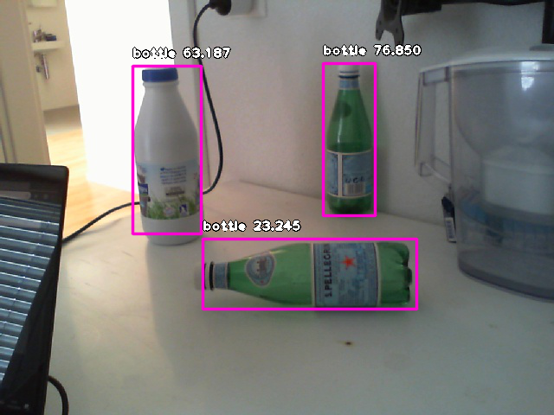
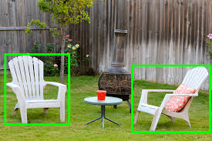
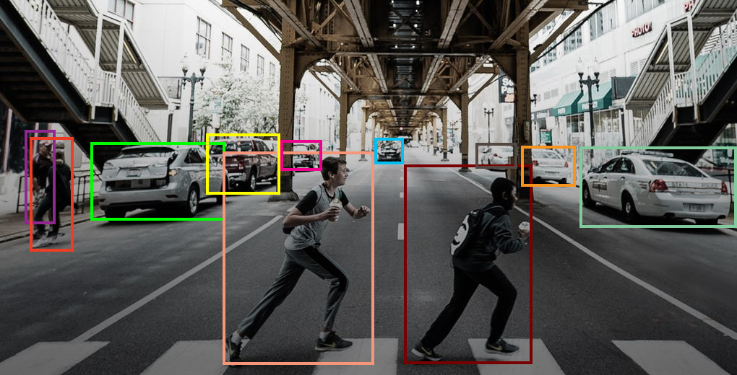
RESULTS

Slide 18
GITHUB LINK
https://github.com/Mohamedyasarali/TNSDC-Generative-AI.git

